Slide 1



Auto-Scraper
AI-Powered Multi-Agent Web Scraping Pipeline
Fully tested scraper
Playwrite
Browser
Custom Code Executer with error classification
URL To Scrape
Scraper Code Saved to Bucket
Analyst
Orchestrator
Validator
Analyze HTML and provide Key findings to:
Orchestrator, to decide on next step (if it is a 1 step scrape or 2 steps)
Coder: a JSON with the selectors it need to get.
Run code and if issues found, decide if it is coding issue or HTML issue, and accordingly return it to the correct agent
Coder
All agents developed using ADK and powered by Gemini 2.5 Flash
Build the scraper based on Analyst input

Slide 2
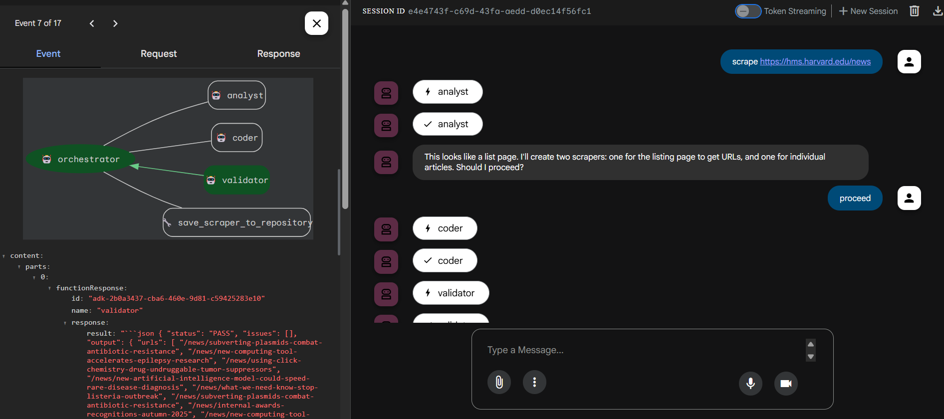
Single line request from user with the desired URL

Slide 3
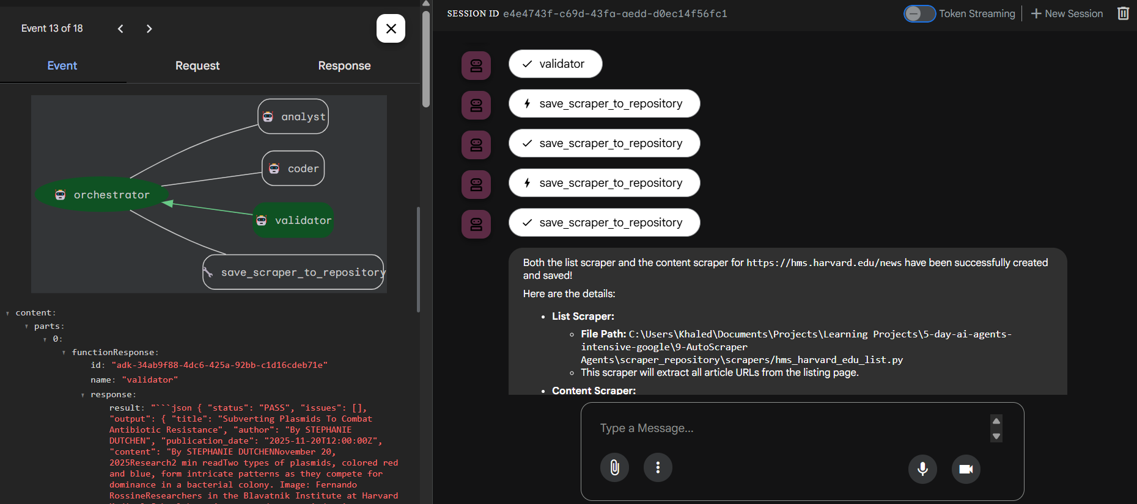
After The Validator confirms that the code is working as expected, the code is saved and Orchestrator responds

Slide 4
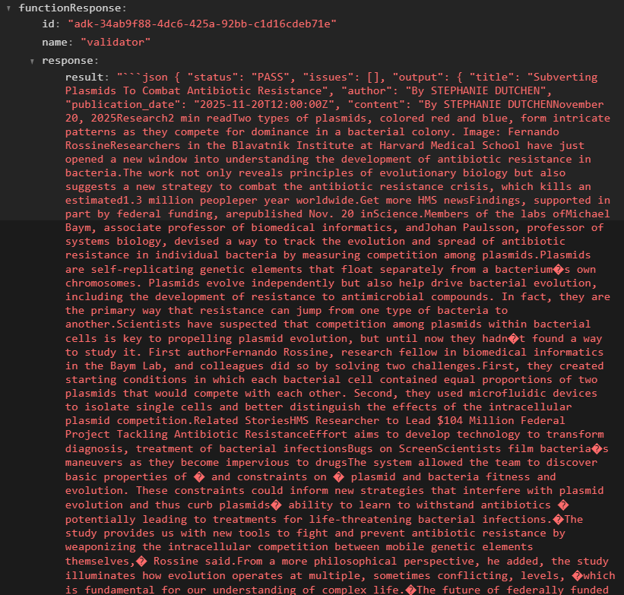
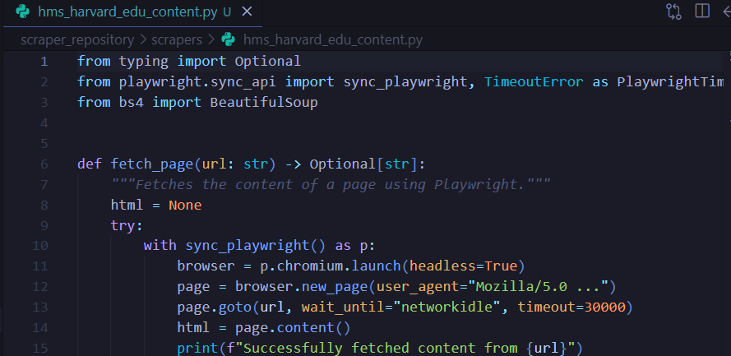
Complete Scraper with clean and tested results in seconds, not days

